Slide 1


Green Pace
Security Policy Presentation
Developer: Cinnamon George

Slide 2

OVERVIEW: DEFENSE IN DEPTH
Overview
In Depth Practices

Slide 3
THREATS MATRIX
How Automation can be Used to Detect the Threats
Likely - The chances of a vulnerability occurring is very high | Priority - Will need to take care of immediately
Low priority -Does not take priority of something of major importance | Unlikely - The chances of the vulnerability occurring is low

Slide 4
10 PRINCIPLES
Validate Input Data
Heed Compiler Warnings
Architect and Design for Security Policies
Keep It Simple
Default Deny
Adhere to the principle of Least Privilege
Sanitize Data Sent to Other Systems
Practice Defense in Depth
Use Effective Quality Assurance Techniques
Adopt a Secure Coding Standard

Slide 5
CODING STANDARDS
Data type
Data Value
String Correctness
SQL Injection
Memory Protection
Assertions
Exceptions
Error Reporting
Abstract Models
Threads

Slide 6
ENCRYPTION POLICIES
Encryption in rest
Encryption at flight
Encryption in Use

Slide 7
TRIPLE-A POLICIES
Authentication
Authorization
Accounting

Slide 8
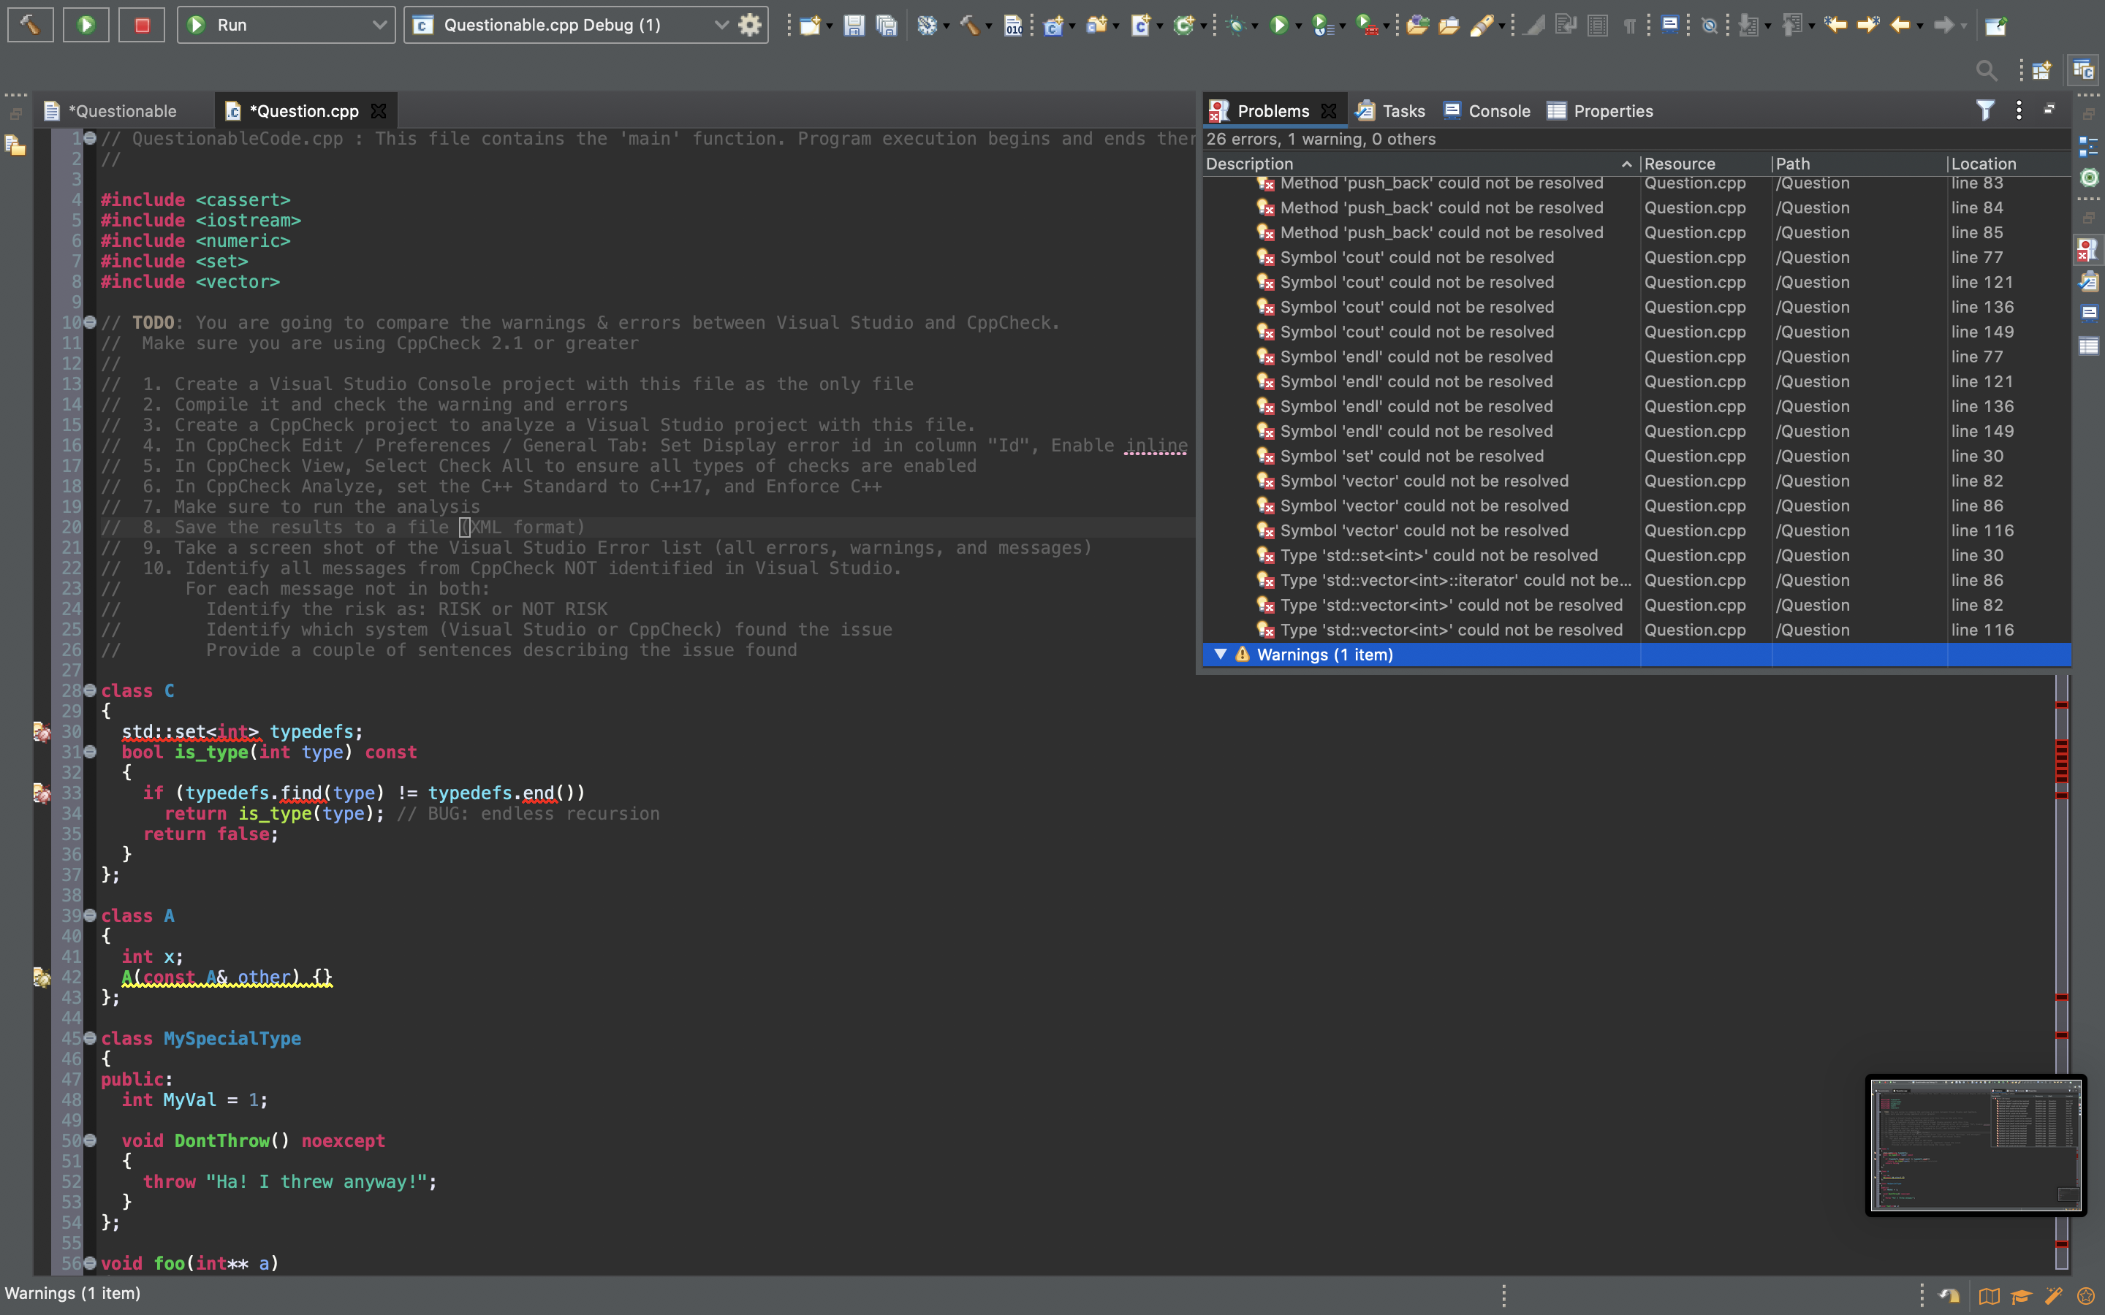
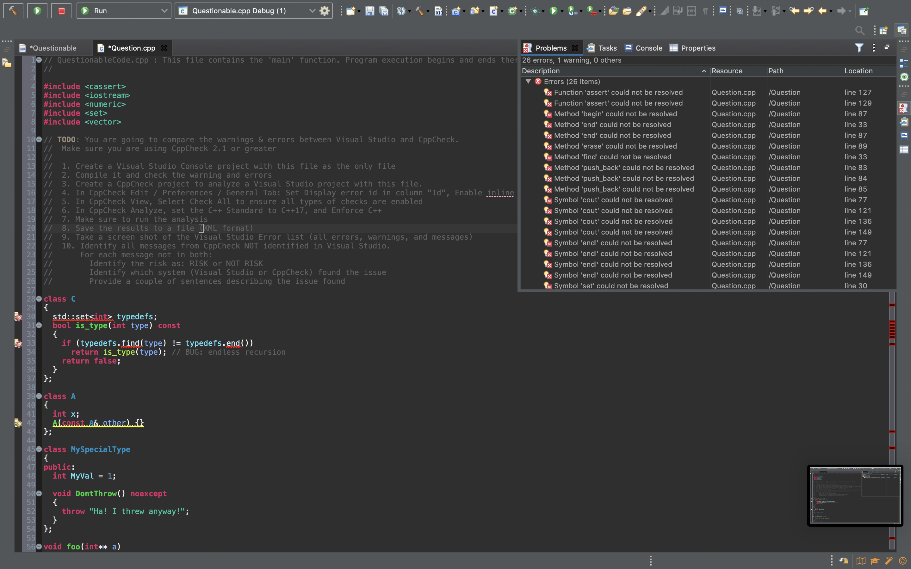
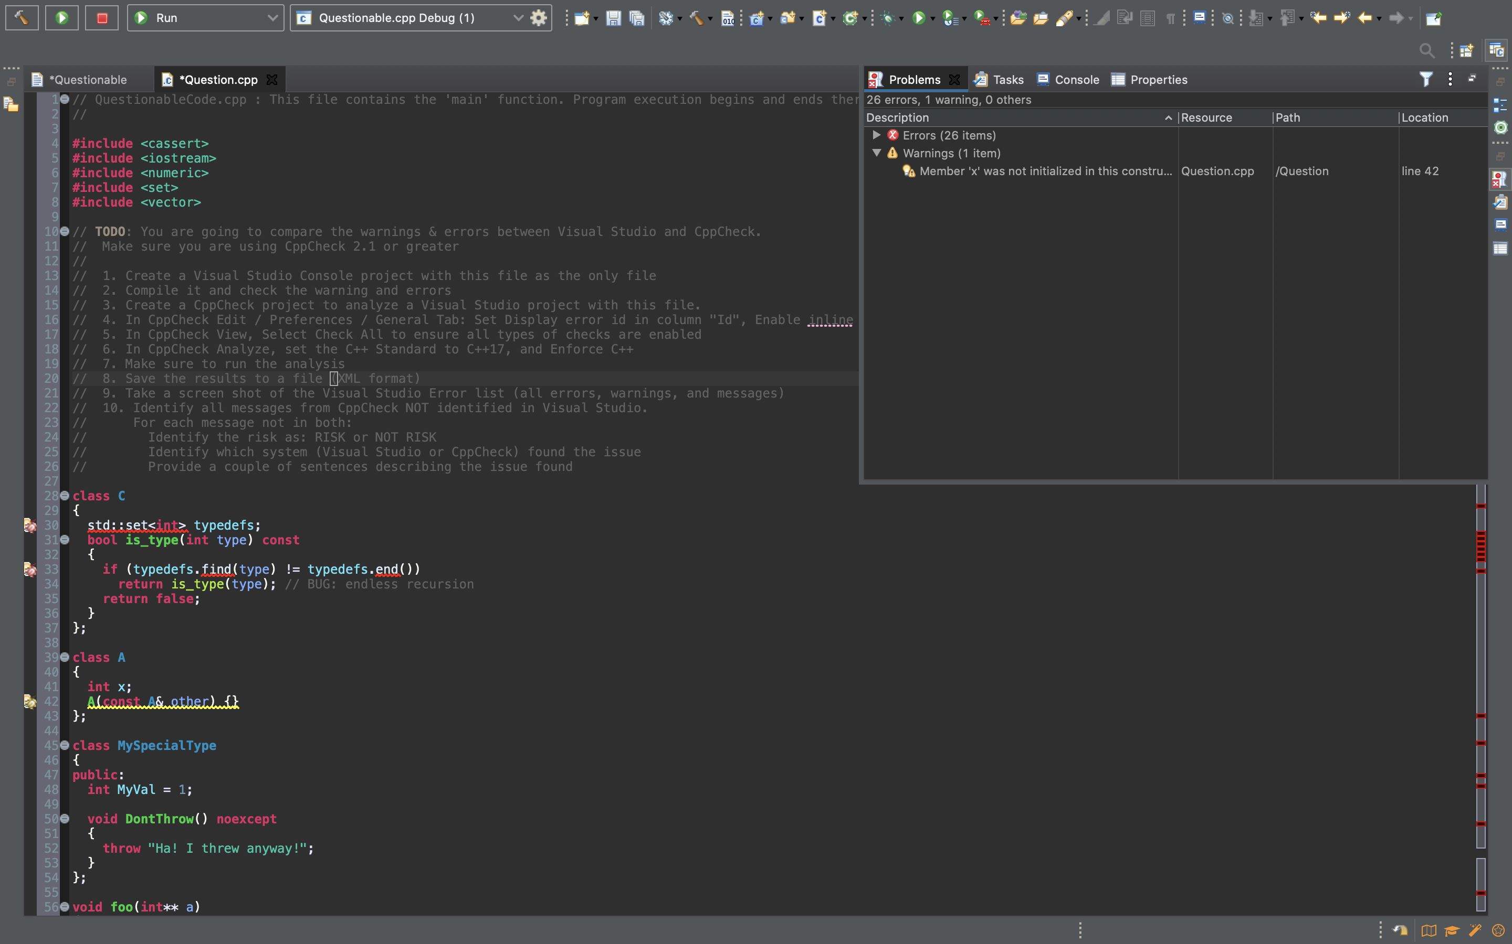
Unit Testing

Slide 9

AUTOMATION SUMMARY

Slide 10
TOOLS
DevSecOps Overview
When and How the tools are going to be used

Slide 11
RISKS AND BENEFITS
Problems / Solutions
Risks and Benefits
Wait to prevent or prevent now
Where is the security lacking and why

Slide 12
RECOMMENDATIONS
Review / Update the security policy
Practice in depth defense regularly
Monitor the system for vulnerabilities
Keep track of the new vulnerabilities that do not fall within coding standards

Slide 13
CONCLUSIONS
Current gaps that the security policy brings
Future Progress

Slide 14
REFERENCES
https://wiki.sei.cmu.edu/confluence/pages/viewpage.action?pageId=88046682

